Slide 1
Virtual Medical Assistant
VMEDICO

Slide 2
Abstract
The Virtual medical assistant is an online web platform to integrate various doctors, patients and testing laboratories.
We named our Virtual Medical assistant as VMEDICO.
Vmedico platform will enable the patients to book appointments, preserve their prescriptions and lab-reports and also it allows patients to set a medication reminders.
Vmedico helps the doctors to track the patients medical history which helps to prescribe a good medicine for the patients.
This Vmedico will eliminate the idle waiting time in the hospital longue.

Slide 3
Functional requirements
Build an application that can be integrated with multiple hospital, health care providers and testing laboratories.
Provision to capture the patient details and their doctor details
To capture prescription details and next appointment date and to send automated reminders.
To track laboratory results and to monitor heath details of patient.
Automated email notification to the doctor and patient

Slide 4
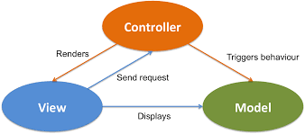
Architecture – MVC Architecture
Model:
The Model component corresponds to all the data-related logic that the user works with.
View:
The View component is used for all the UI logic of the application.
Controller:
Controllers act as an interface between Model and View components to process all the business logic and incoming requests.

Slide 5



Technical stack
Front end – JSP
Programming Language - Java
Backend – Spring boot
Data base – MySQL
IDEs used – Spring Tool Suite (STS), MySQL work bench

Slide 6
Dependencies:
spring-boot-starter-data-jpa :
Spring Boot provides spring-boot-starter-data-jpa dependency to connect Spring application with relational database efficiently.
spring-boot-starter-web :
The spring-boot-starter-web dependency transitively pulls in all dependencies related to web development.
spring-boot-starter-mail:
Starter for using Java Mail and Spring Framework's email sending support.
tomcat-jasper:
Jasper parses JSP files to compile them into Java code as servlets.
mysql-connector-java:
This is a driver to connect your database and application program.

Slide 7



Targeted End- users
Patients
Doctors from various hospitals
Testing laboratories
Patients
Doctors
Testing -labs

Slide 8

Features for patients
Book an appointment with doctors and testing laboratories.
Cancel an appointment
View the status of appointment
Many specialists and testing laboratories are available on one platform.
Prescription download
Medication reminder
Reminder on the day of appointment.

Slide 9
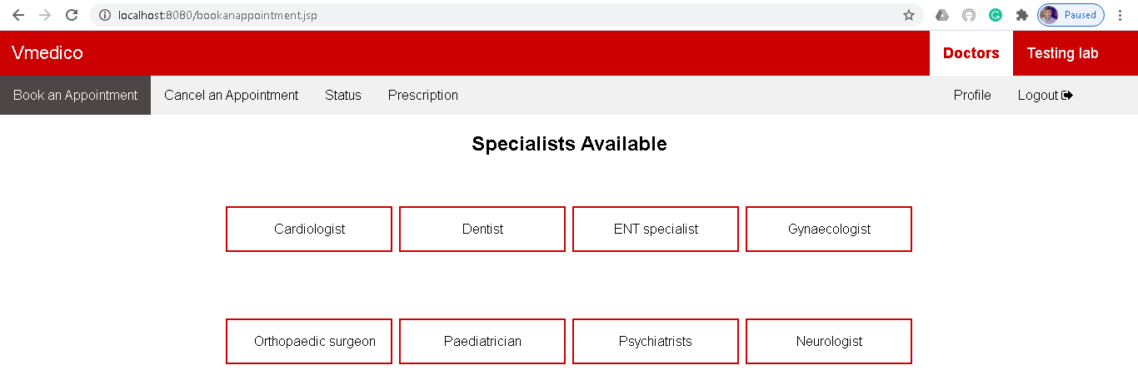
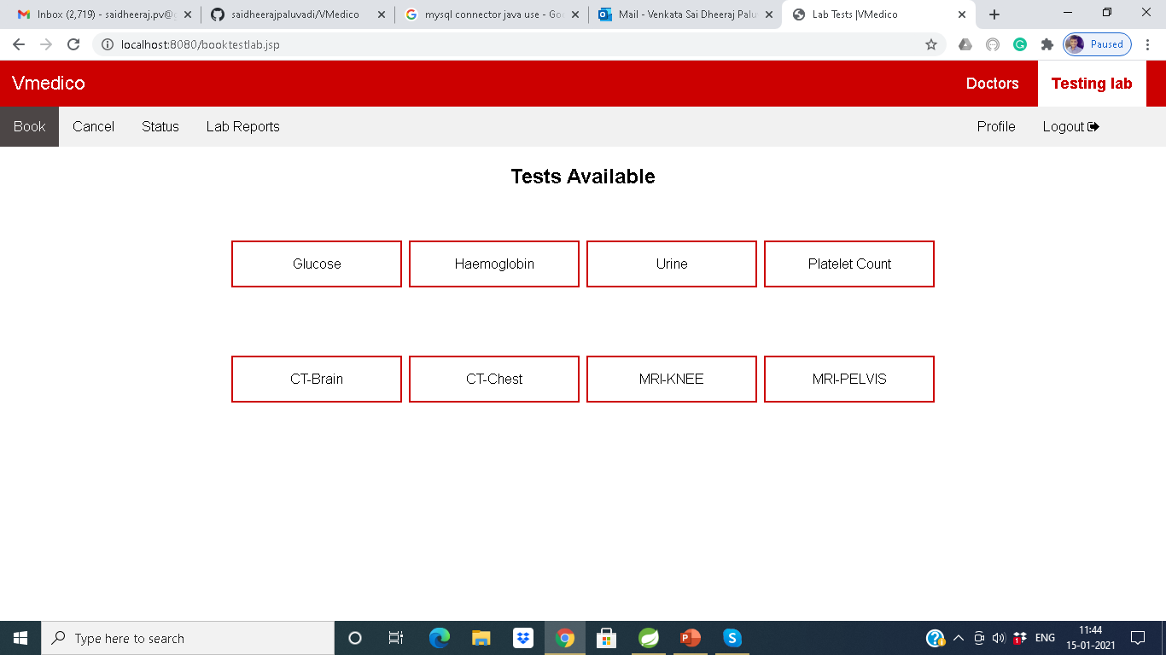

Slide 10

Features for doctors
Easy to connect with various users.
Track the patient’s medical history.
Reminder mail about the appointments with various patients.
Decreases the pressure over the hospital receptionists.
Reduces the idle waiting time in the hospital longue.

Slide 11
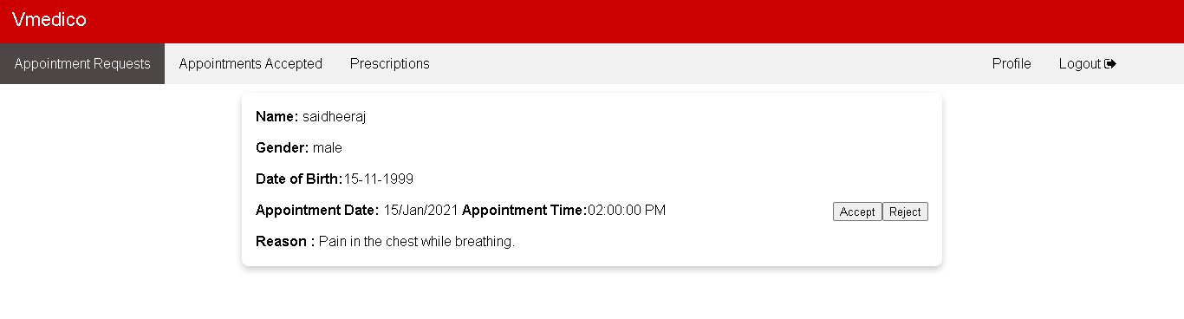
Doctor’s Tab

Slide 12

Features for testing laboratories
Easy to connect with various users.
Reminder mail about the appointments with various patients.
Decreases the pressure over the test – lab receptionists.
Reduces the idle waiting time in the longue.

Slide 13
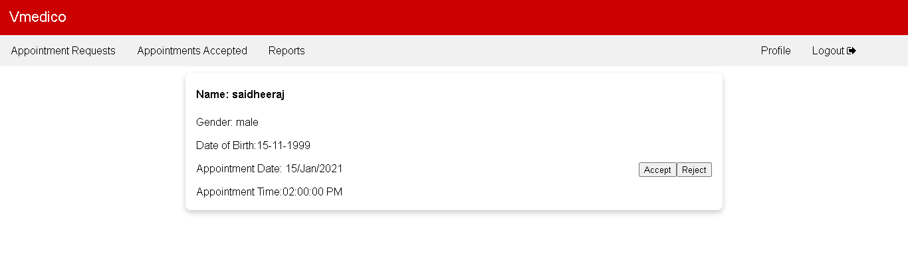
Testing Lab’s Tab

Slide 14
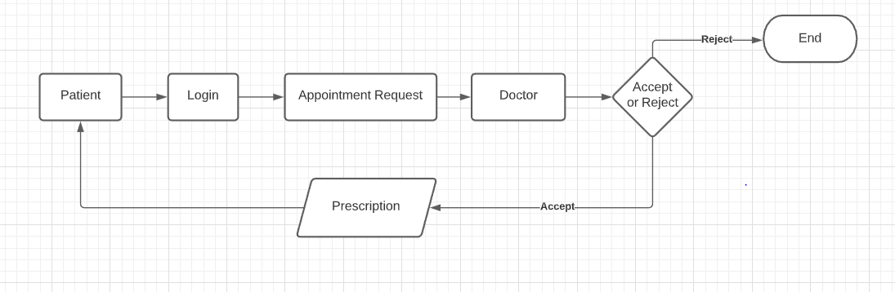
Flow control between Patient and Doctor

Slide 15
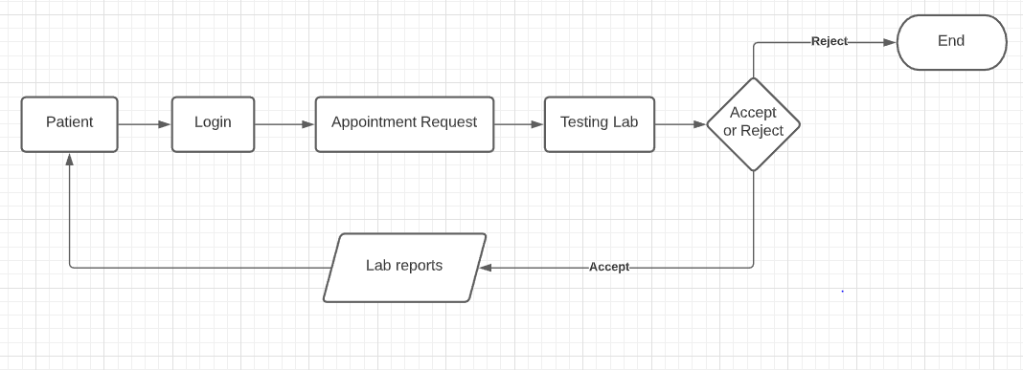
Flow control between Patient and Testing lab

Slide 16
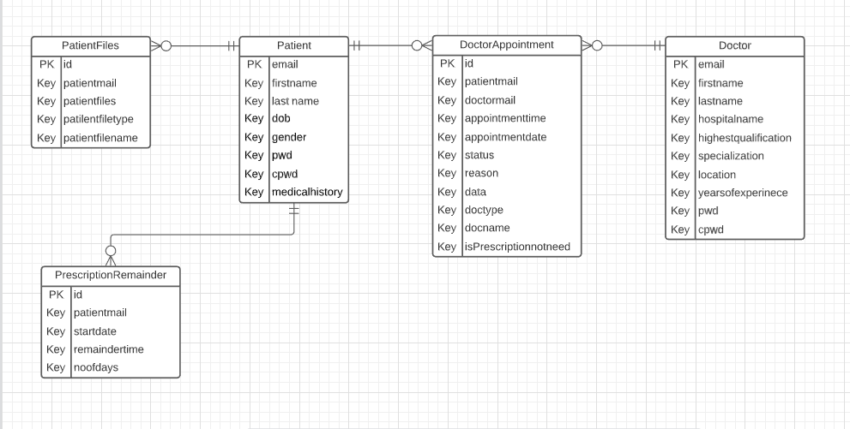
Entity relationship between Patient and Doctor

Slide 17
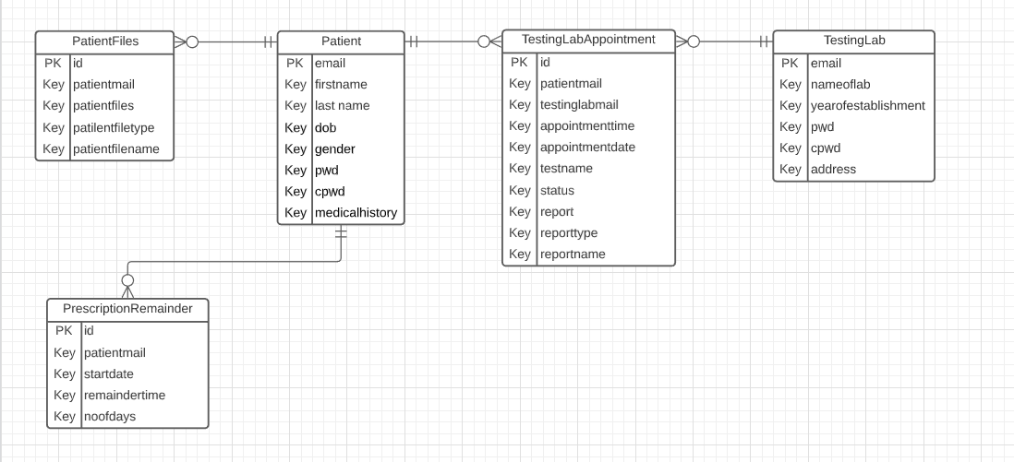
Entity relationship between Patient and Testing Lab

Slide 18
References
https://www.javatpoint.com/spring-tutorial
https://www.tutorialspoint.com/spring/index.htm
https://youtube.com/playlist?list=PLsyeobzWxl7oA8QOlMtQsRT_I7Rx2hoX4
https://www.baeldung.com/learn-spring-course

